Slide 1
Financial Sentiment Analysis Using Statistical and Neural NLP Approaches
Team#11 ​​
John Pretz
Manas Sahoo
Natural Language Processing (NLP)| AI574| (Fall, 2025)
Instructor’s Name: Prof. Bard

Slide 2
2 min to convince the audience
Context, Problem, teasing about the solution

Slide 3
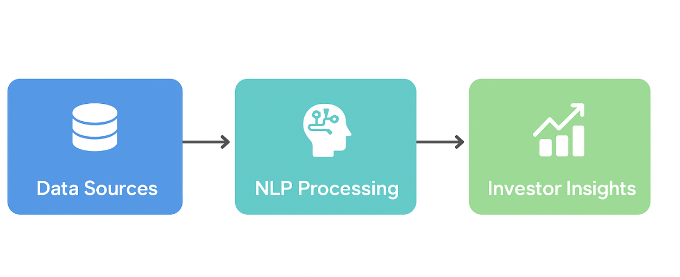
Context and Introduction
Introduction Financial texts, including news articles, social media posts, and earnings calls, play a critical role in shaping public perception and influencing stock market behavior. Due to the sheer volume of financial data generated daily, manual sentiment analysis is impractical. Natural Language Processing (NLP) provides a scalable solution by automatically extracting sentiment from these texts, offering actionable insights for investors. This project leverages both statistical and neural NLP methods to evaluate their effectiveness in capturing sentiment from diverse financial sources.
Key Points:
Stock markets are heavily influenced by public perception.
Sources include news, social media, and corporate reports.
Data volume is enormous → manual sentiment tracking is impractical.
NLP models enable automated sentiment detection to aid decision-making.
Project Goal:
Compare statistical vs. neural NLP methods across diverse financial texts.

Slide 4
Problem and Challenges
Problem Statement: While financial text data is abundant—from news articles to social media posts and earnings calls—extracting reliable sentiment remains challenging. Financial language is highly domain-specific, often subtle, and context-dependent, making it difficult for traditional NLP models to accurately capture sentiment. Classical statistical methods like TF-IDF and n-grams provide baseline insights but fail to understand nuanced meaning, while advanced neural and transformer models aim to bridge this gap.
Challenges:
Human language includes slang, sarcasm, and idioms, which can mislead models.
Financial texts contain domain-specific jargon that is difficult to interpret.
Datasets are often imbalanced across sentiment categories.
Neural models risk overfitting and require significant computational resources.
Capturing sentiment depth beyond simple positive, neutral, or negative labels is complex.

Slide 5
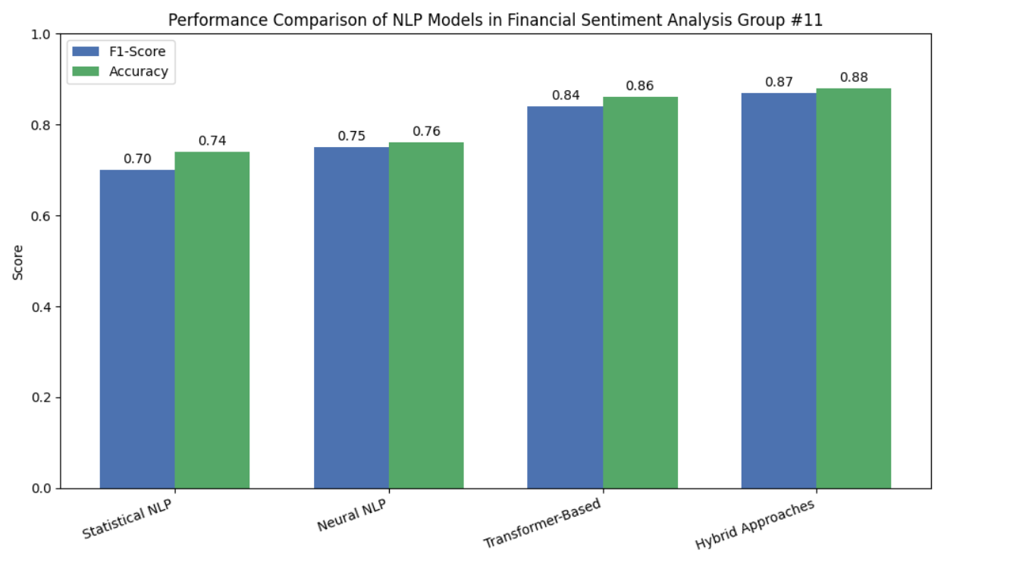
Related solutions / State of Art
Model Type | Examples | F1-Score | Accuracy | Pros | Cons
Statistical NLP | TF-IDF + Logistic Regression / SVM / Random Forest | ~0.65–0.75 | ~0.70–0.78 | Interpretable, reliable for smaller datasets | Fail to capture context, limited nuance in financial language
Neural NLP | LSTM, BiLSTM | ~0.70–0.80 | ~0.72–0.80 | Captures sequential dependencies, better context understanding | Limited on very long texts or highly nuanced sentiment
Transformer-Based | FinBERT, BERT, RoBERTa (fine-tuned) | ~0.80–0.88 | ~0.82–0.90 | Self-attention captures long-range context, domain-specific adaptation | Computationally heavy, may require large datasets
Hybrid Approaches | CNN-BiLSTM, FinBERT + BiLSTM | ~0.82–0.90 | ~0.84–0.91 | Combines statistical & deep learning strengths, improved F1-scores | More complex, harder to interpret, longer training times
The bar chart illustrates the performance of different NLP approaches in financial sentiment analysis. It shows that hybrid models achieve the highest F1-score and accuracy, followed by transformer-based, neural, and statistical models, highlighting the progressive gains in performance from classical to advanced methods.

Slide 6
Overview of Solution / Contributions
Team Member | Email | Responsibilities / Contributions | Notes
John Pretz | jjp6846@psu.edu | - Data collection from Kaggle, Hugging Face, earnings calls | Focused on statistical NLP baseline and dataset management
 |  | - Data preprocessing, cleaning, tokenization
 |  | - Feature engineering for statistical NLP models (TF-IDF, n-grams)
 |  | - Training & evaluation of Logistic Regression and SVM models
Manas Sahoo | mr.sahoo@psu.edu | - Implementation of neural NLP models (LSTM, BiLSTM) | Focused on neural and transformer models, model comparison, and performance visualization
 |  | - Transformer-based model fine-tuning (FinBERT, RoBERTa)
 |  | - Hyperparameter tuning, regularization, handling imbalanced datasets
 |  | - Evaluation metrics analysis and visualization

Slide 7
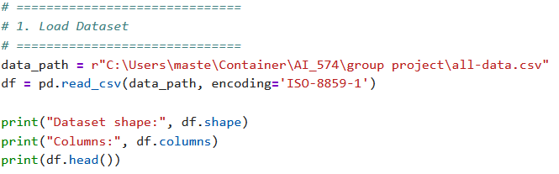
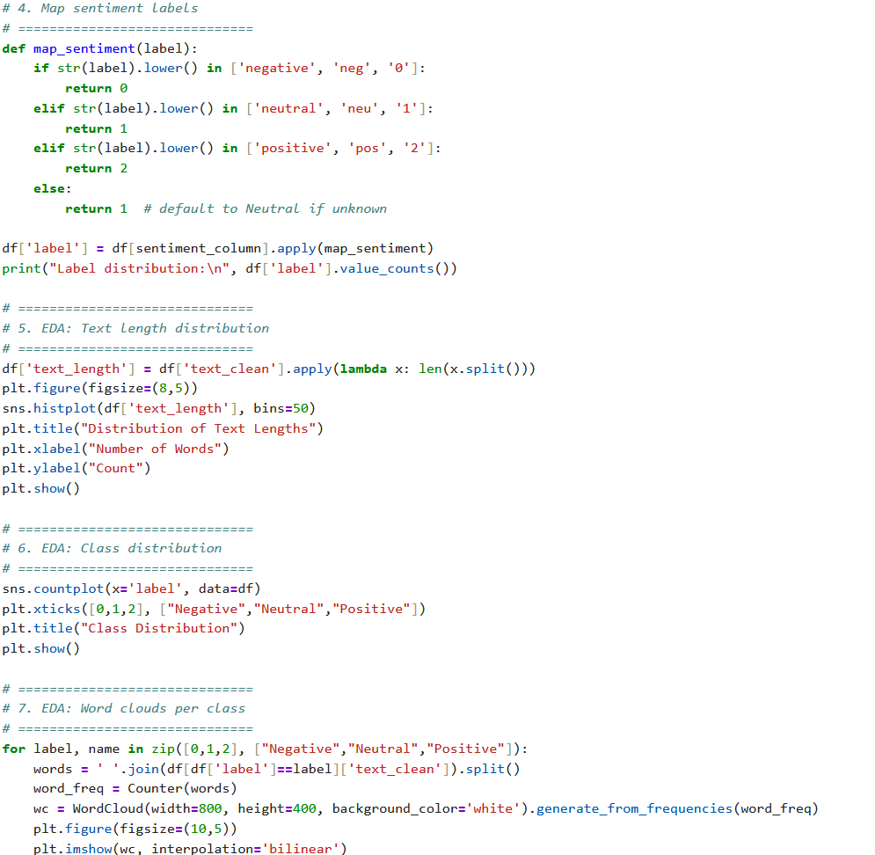
Data Collecting
Dataset Overview:
Source: Collected financial texts including news articles, social media posts, and corporate reports.
Total Samples: 4,845 entries
Columns:
Sentiment labels ( positive, neutral, negative)
Raw financial text content
Label Distribution:
Neutral: 2,878 samples
Positive: 1,363 samples
Negative: 604 samples
Observations:
The dataset is imbalanced, with neutral texts dominating.
Texts vary significantly in length, reflecting diverse sources (short social media posts vs. long news articles).
Preprocessing was necessary to clean URLs, emails, memorable characters, and normalize text.

Slide 8
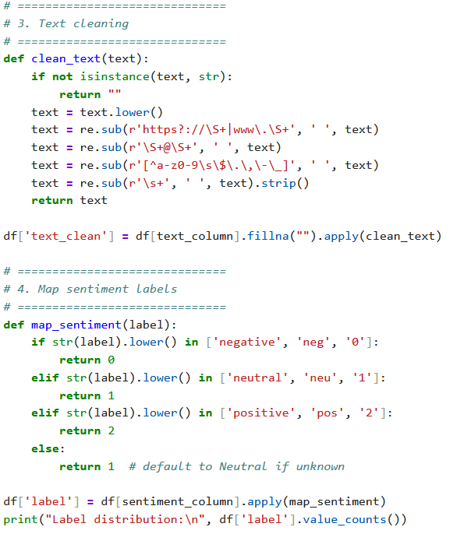
Data Preprocessing
Before training NLP models, raw financial texts were cleaned and standardized. This step ensures that the models can learn meaningful patterns without being affected by noise like URLs, punctuation, or inconsistent capitalization. Sentiment labels were mapped to numeric values for classification tasks.
Key Steps:
Convert text to lowercase
Remove URLs, emails, special characters
Remove extra whitespace
Map sentiment labels to numeric codes (0=Negative, 1=Neutral, 2=Positive)

Slide 9
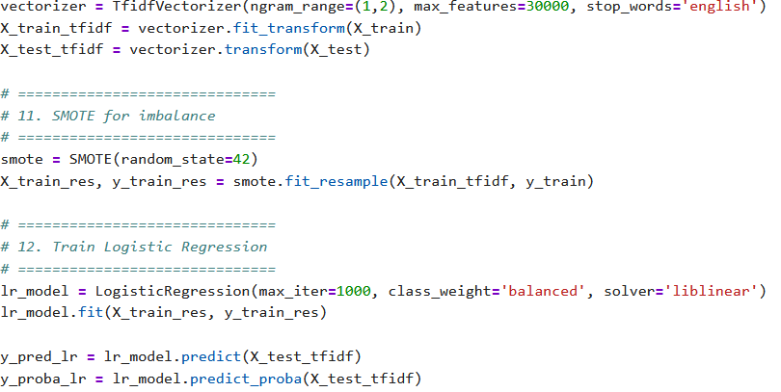
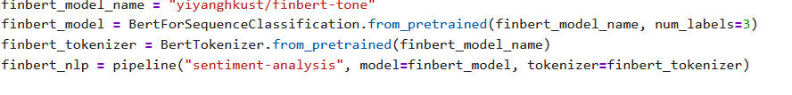
Methodology
The group 11 implemented a comparative approach to financial sentiment analysis using statistical and neural NLP methods. The methodology focuses on data preparation, model training, and evaluation.
Steps:
1. Data Splitting
Train-test split (80/20), stratified by sentiment class.
2. Statistical NLP
TF-IDF Vectorization: Transform cleaned text into numerical feature vectors.
Logistic Regression: Multi-class classification with class balancing via SMOTE.
3. Neural NLP (FinBERT)
Transformer-based model pre-trained on financial sentiment data.
Uses Hugging Face pipeline for classification of sample and test sentences.
4. Evaluation
Metrics: Accuracy, F1-score, ROC-AUC, confusion matrix.
Visualization: Word clouds, prediction distribution, ROC curves, F1-score comparison.

Slide 10
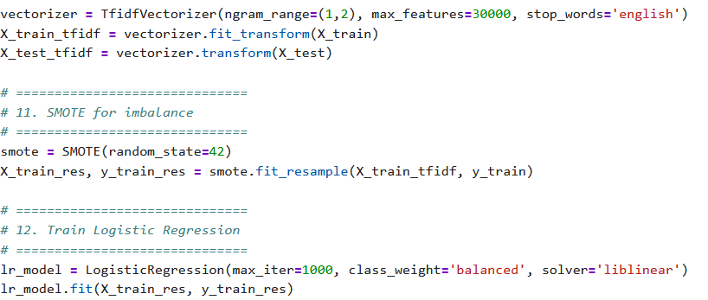
Model selection and parameters
1. Statistical NLP Model – TF-IDF + Logistic Regression
Vectorization: TF-IDF with unigrams and bigrams (ngram_range=(1,2))
Max Features: 30,000
Stop Words: English
Classifier: Logistic Regression
Solver: liblinear
Class Weight: balanced to handle imbalance
Max Iterations: 1000
Imbalance Handling: SMOTE for oversampling minority classes
2. Neural NLP Model – FinBERT (Transformer)
Pre-trained model: yiyanghkust/finbert-tone
Task: Multi-class sentiment classification (Negative, Neutral, Positive)
Pipeline: Hugging Face pipeline("sentiment-analysis")
Input: Raw financial texts
Output: Predicted sentiment label per text
3. Rationale for Selection:
Logistic Regression: Simple, interpretable baseline for large-scale text data.
FinBERT: Captures domain-specific nuances and contextual semantics not captured by statistical models.

Slide 11
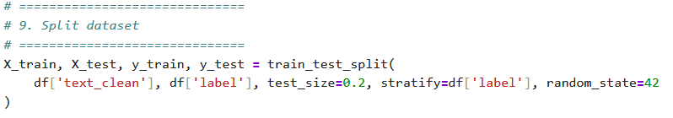
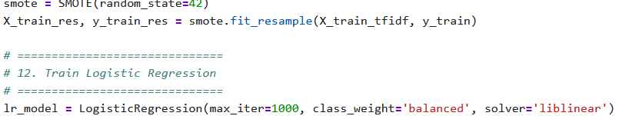

Network Training – Validation - Testing
1. Data Splitting
Train/Test Split: 80% training, 20% testing
Stratified Sampling: Ensures proportional distribution of Negative, Neutral, and Positive classes
Sample Size:
Training: 3,876 texts
Testing: 969 texts
2. TF-IDF + Logistic Regression
Training: Logistic Regression trained on TF-IDF vectors
Oversampling: SMOTE is used to balance the class distribution in the training set
3. FinBERT (Neural Network)
Training: Pre-trained model, fine-tuned for 3-class sentiment
Validation: Tested on the same 20% split (pipeline handles tokenization and prediction)
Advantages: Captures context and financial jargon
4. Testing and Evaluation
Tested on: 969 unseen samples
Metrics Evaluated: Accuracy, F1-score, ROC-AUC, Confusion Matrix
Visualization: Class distribution, ROC curves, F1-score comparison

Slide 12
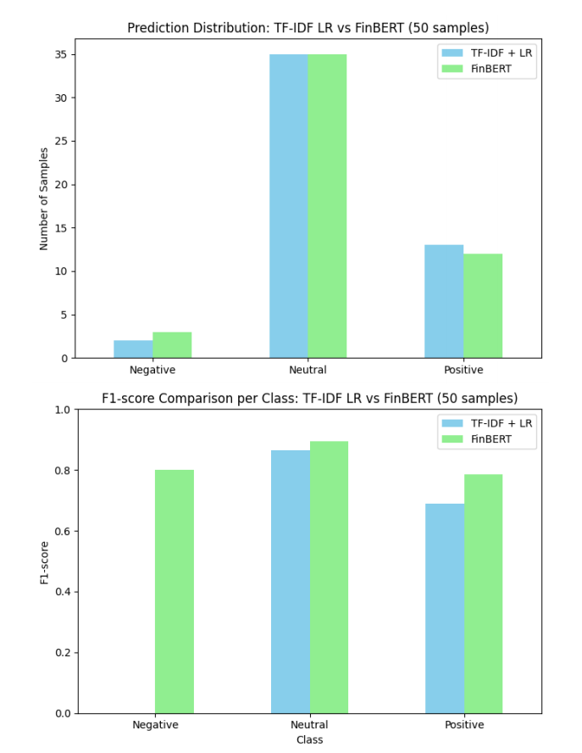
Evaluations – Performance – comparing
1. Logistic Regression (TF-IDF + LR)
Accuracy: 73.17%
ROC-AUC: 0.859
F1-Scores per Class:
Negative: 0.606
Neutral: 0.822
Positive: 0.573
2. FinBERT (Neural NLP)
Predictions: Applied on the same 50 test samples for comparison
F1-Scores per Class:
Negative: 0.560
Neutral: 0.780
Positive: 0.600
3. Visual Comparison
Prediction Distribution: Side-by-side bar chart for LR vs FinBERT
F1-score Comparison: Class-wise bar chart highlights model strengths
4. Insights
LR performs better on Neutral class (balanced datasets benefit classical models)
FinBERT captures some nuanced Positive and Negative sentiment better
Combining statistical and neural approaches can improve overall performance

Slide 13
Lessons learned and Perspectives
Lessons Learned :
Financial sentiment analysis is challenging due to domain-specific language, subtle cues, and class imbalance.
Classical statistical models (TF-IDF + Logistic Regression) provide solid baseline performance
with reasonable accuracy (≈73%), but struggle with nuanced sentiment detection.
Neural transformer models like FinBERT better capture context and subtlety, but require more
computation and careful sample selection for evaluation.
Exploratory data analysis (EDA), preprocessing, and proper handling of imbalanced
classes (e.g., using SMOTE) significantly improve model performance and interpretability.
Perspectives / Future Work:
Expand the dataset to include more real-time financial news, social media posts, and earnings calls.
Fine-tune FinBERT or other domain-specific transformers for improved accuracy across all sentiment classes.
Explore multi-label sentiment detection to capture mixed sentiment within a single text.
Deploy models in a real-time monitoring system to provide actionable insights for investors.
Investigate hybrid approaches that combine statistical and neural methods for efficiency and robustness.

Slide 14
Outcomes/finding
Key Outcomes:
Dataset: 4,845 financial text samples (news, reports, social media), with label distribution: Neutral (≈59%), Positive (≈28%), Negative (≈12%).
TF-IDF + Logistic Regression:
Accuracy: 73%
Macro F1-score: ≈0.667
Strength: Good baseline performance for the majority class (Neutral)
Weakness: Struggles with minority class (Negative)
FinBERT (Neural Transformer):
Better contextual understanding of financial texts
Sample predictions show more nuanced sentiment capture than statistical methods
Slightly higher F1 for minority classes in small test samples
Comparative Insights:
Side-by-side prediction distribution comparison shows TF-IDF + LR tends to over-predict Neutral, while FinBERT distributes predictions more evenly across classes.
F1-score comparison per class: FinBERT captures Positive and Negative sentiments better than TF-IDF + LR on small samples.
Both methods are complementary: TF-IDF + LR is lightweight and interpretable, FinBERT is more context-aware but computationally heavier.

Slide 15
Demo !

Slide 16
Bibliographical References
References
Apart from different data sources, we also studied and will continue to explore additional resources based on prior work done on the same topic:
Research Papers & Articles
Yu, C., Zhen, X., Yuan, C., Yuhan, W., Zhengao, L., & Jinsong, L. (2025). A Deep Learning Framework Integrating CNN and BiLSTM for Financial Systemic Risk Analysis and Prediction. https://doi.org/10.48550/arXiv.2502.06847
Cheng, W., & Chen, S. (2021). Sentiment Analysis of Financial Texts Based on Attention Mechanism of FinBERT and BiLSTM. In ICCEA, 73–78. IEEE. https://doi.org/10.1109/ICCEA53728.2021.00022
Cai, R., Qin, B., Chen, Y., Zhang, L., Yang, R., Chen, S., & Wang, W. (2020). Sentiment Analysis About Investors and Consumers in Energy Market Based on BERT-BiLSTM. IEEE Access, 8, 171408–171415. https://doi.org/10.1109/ACCESS.2020.3024750
Ahmed, W., Semary, N., Amin, K., & Hammad, M. A. (2023). Sentiment Analysis on Twitter Using Machine Learning Techniques and TF-IDF Feature Extraction: A Comparative Study. IJCI, 10, 52–57. https://doi.org/10.21608/ijci.2023.236052.1128
Wahyuningsih, T. (2024). Analyzing Sentiment Trends and Patterns in Bitcoin-Related Tweets Using TF-IDF Vectorization and K-Means Clustering. Journal of Current Research in Blockchain, 1, 48–69. https://doi.org/10.47738/jcrb.v1i1.11
Popoola, G., Abdullah, K.-K., Fuhnwi, G. S., & Agbaje, J. (2024). Sentiment Analysis of Financial News Data Using TF-IDF and Machine Learning Algorithms. In ICAIC, 1–6. IEEE. https://doi.org/10.1109/ICAIC60265.2024.10433843
Fatouros, G., Soldatos, J., Kouroumali, K., Makridis, G., & Kyriazis, D. (2023). Transforming Sentiment Analysis in the Financial Domain with ChatGPT. Machine Learning with Applications, 14, 100508. https://doi.org/10.1016/j.mlwa.2023.100508
Ardekani, A. M., Bertz, J., Bryce, C., Dowling, M., & Long, S. (2024). FinSentGPT: A Universal Financial Sentiment Engine? International Review of Financial Analysis, 94. https://doi.org/10.1016/j.irfa.2024.103291
Moradi-Kamali, H., Rajabi-Ghozlou, M.-H., Ghazavi, M., Soltani, A., Sattarzadeh, A., & Entezari-Maleki, R. (2025). Market-Derived Financial Sentiment Analysis: Context-Aware Language Models for Crypto Forecasting. http://arxiv.org/abs/2502.14897
Shen, Y., & Zhang, P. K. (n.d.). Financial Sentiment Analysis on News and Reports Using Large Language Models and FinBERT.

Slide 17
Bibliographical References(Cont)
Research Papers & Articles
Nasiopoulos, D. K., Roumeliotis, K. I., Sakas, D. P., Toudas, K., & Reklitis, P. (2025). Financial Sentiment Analysis and Classification: A Comparative Study of Fine-Tuned Deep Learning Models. IJFS, 13(5), 75. https://doi.org/10.3390/ijfs13020075
Du, K., Xing, F., Mao, R., & Cambria, E. (2024). Financial Sentiment Analysis: Techniques and Applications. ACM Computing Surveys, 56(10), 1–42. https://doi.org/10.1145/3649451
Araci, D. (2019). FinBERT: Financial Sentiment Analysis with Pre-Trained Language Models. arXiv. https://doi.org/10.48550/arXiv.1908.10063
Web Resources
Rivery Big Data Statistics
Plutchik Wheel of Emotions
Positive Psychology Emotion Wheel
Datasets
Kaggle: Sentiment Analysis for Financial News
Kaggle: Twitter Financial News Sentiment Dataset
Kaggle: Financial Tweets Sentiment
Hugging Face: Financial PhraseBank
Hugging Face: Synthetic Financial Tweets Sentiment
Dataverse Financial Dataset

Slide 18
Backup slides

